Slide 1

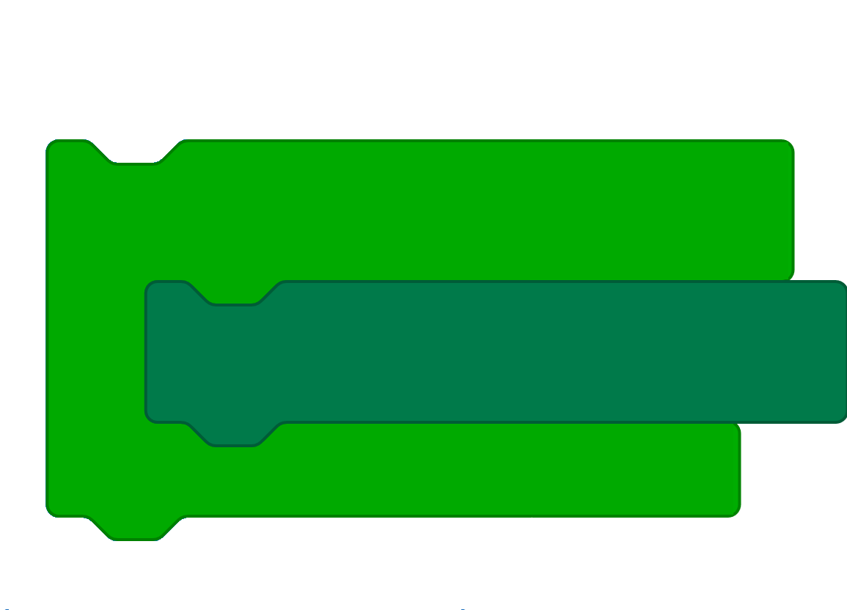
Microsoft MakeCode
Jacqueline Russell
Daryl Zuniga
Hands-on Computing Education
Program Manager
Software Engineer

Slide 2


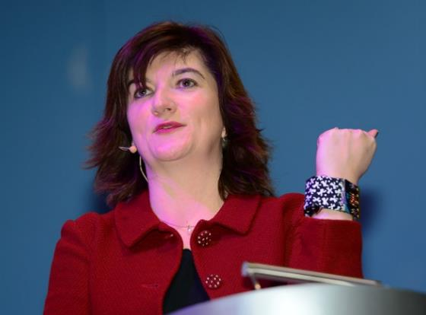
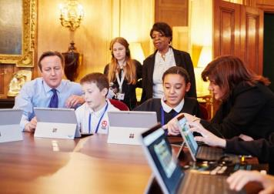
Micro:bit wrist cuff
Nicky Morgan, UK Education Secretary
David Cameron, UK Prime Minister
Notes:
In 2015, the BBC decided to revive this project
2015 – BBC partnered with ARM, Microsoft and others to build the micro:bit to engage all students in computational thinking
BBC gave away a micro:bit to every Year 7 student in the UK

Slide 3
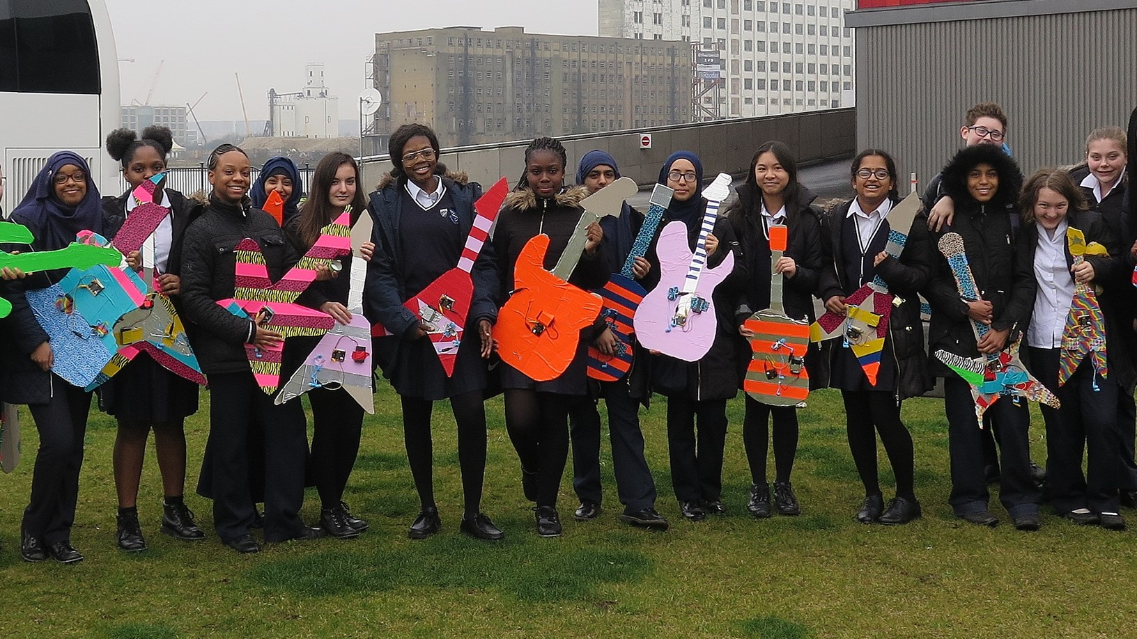
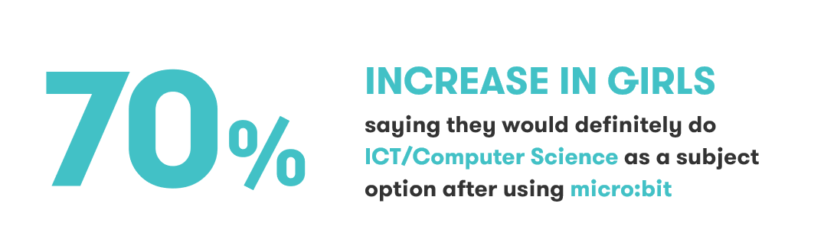
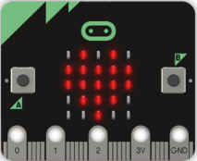
Notes:
And we are starting to see evidence that this approach is working
In the UK in 2016, the BBC distributed a million micro:bits to Year 7 students across the nation
The following year, they conducted a national study among students who had been using the micro:bit, and found a 70% increase in interest among girls to continue with Computer Science (https://microbit.org/research)
There is also a good research whitepaper on the benefits of Physical Computing in Computer Science Education: https://aka.ms/physicalcomp

Slide 4
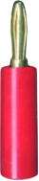
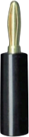
The micro:bit
Display
5x5 LED Matrix
Push buttons
Touch and Input/Output Pins
(for connecting other
components and sensors)
External Power supply
3.3V in or battery V out
Holes for banana plugs
“Edge Connector"
Pads for crocodile clips
Notes:
Hardware:
Tested design re-used and extended for BBC
micro:bit is mbed Enabled
Compatible with ecosystem
Software:
Components and accessories already supported in mbed
new work will enhance other mbed targets
Binaries:
Editor for schools sends code to mbed services
Abstracts complexity of embedded compilation for partners

Slide 5
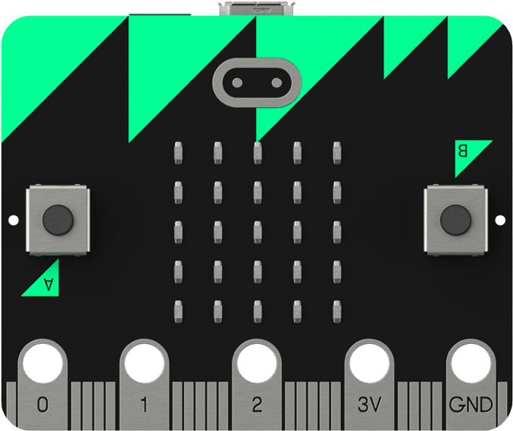
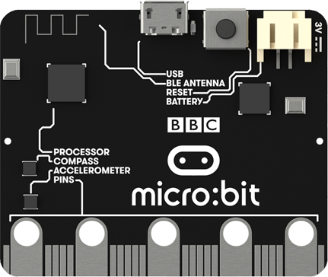
Micro USB
Power and Programming
Reset Button
Antenna (Bluetooth & RADIO)
Main Processor
Nordic nRF51822
Battery connector
(2xAAA)
Magnetometer
Interface Processor
Provides drag-and-drop
Acceleromater
https://www.microbit.org/guide/features/
Notes:
The micro:bit is packed with technology as well, making it possible for weeks worth of coding projects without extra accessories
The USB acts as a flash drive on any computer, just drag and drop your program and it works!
Built-in Bluetooth enables interaction with our iOS and Android app, and even peer-to-peer radio networking between micro:bits
On-board sensors for acceleration and compass allow lots of interesting interaction events like “On Shake”

Slide 6
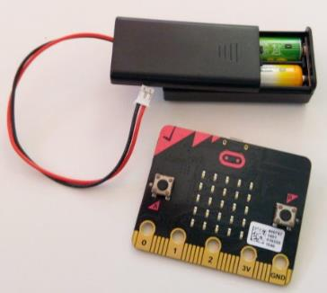
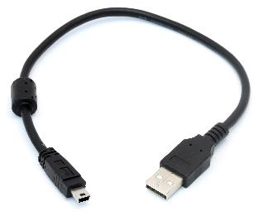
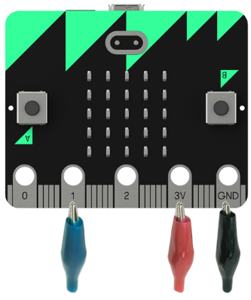
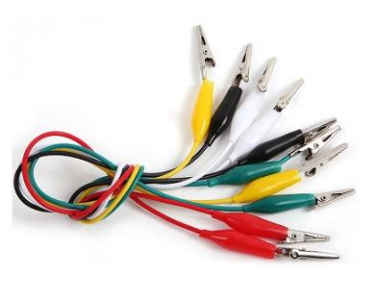
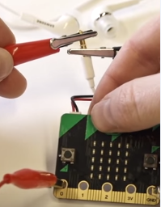
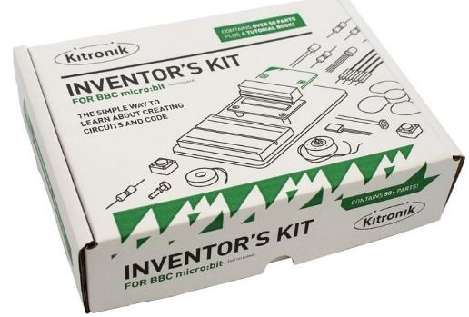
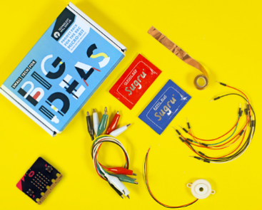
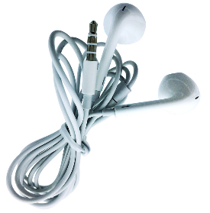
Micro:bit Kits & Accessories
Battery Pack & USB cable
http://microbit.org/resellers/
$16
Crocodile Clips
Headphones
Maker Kits

Slide 7
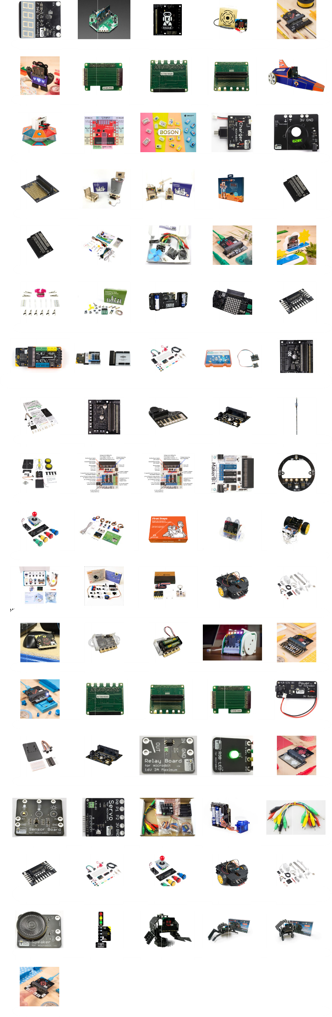

Slide 9
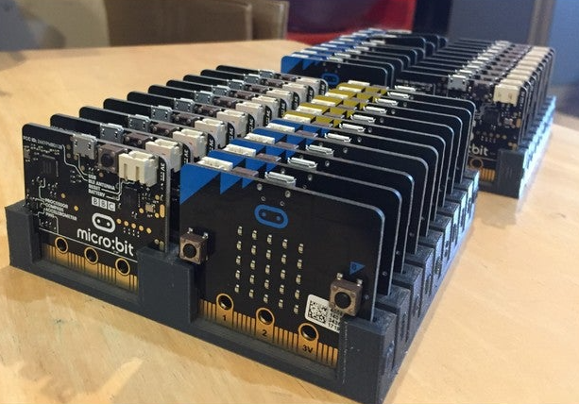
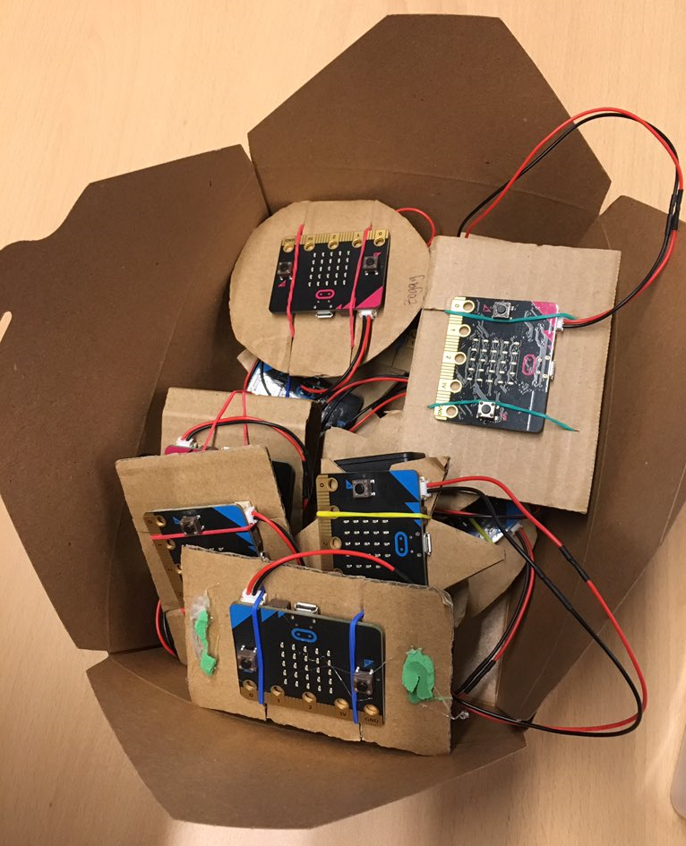
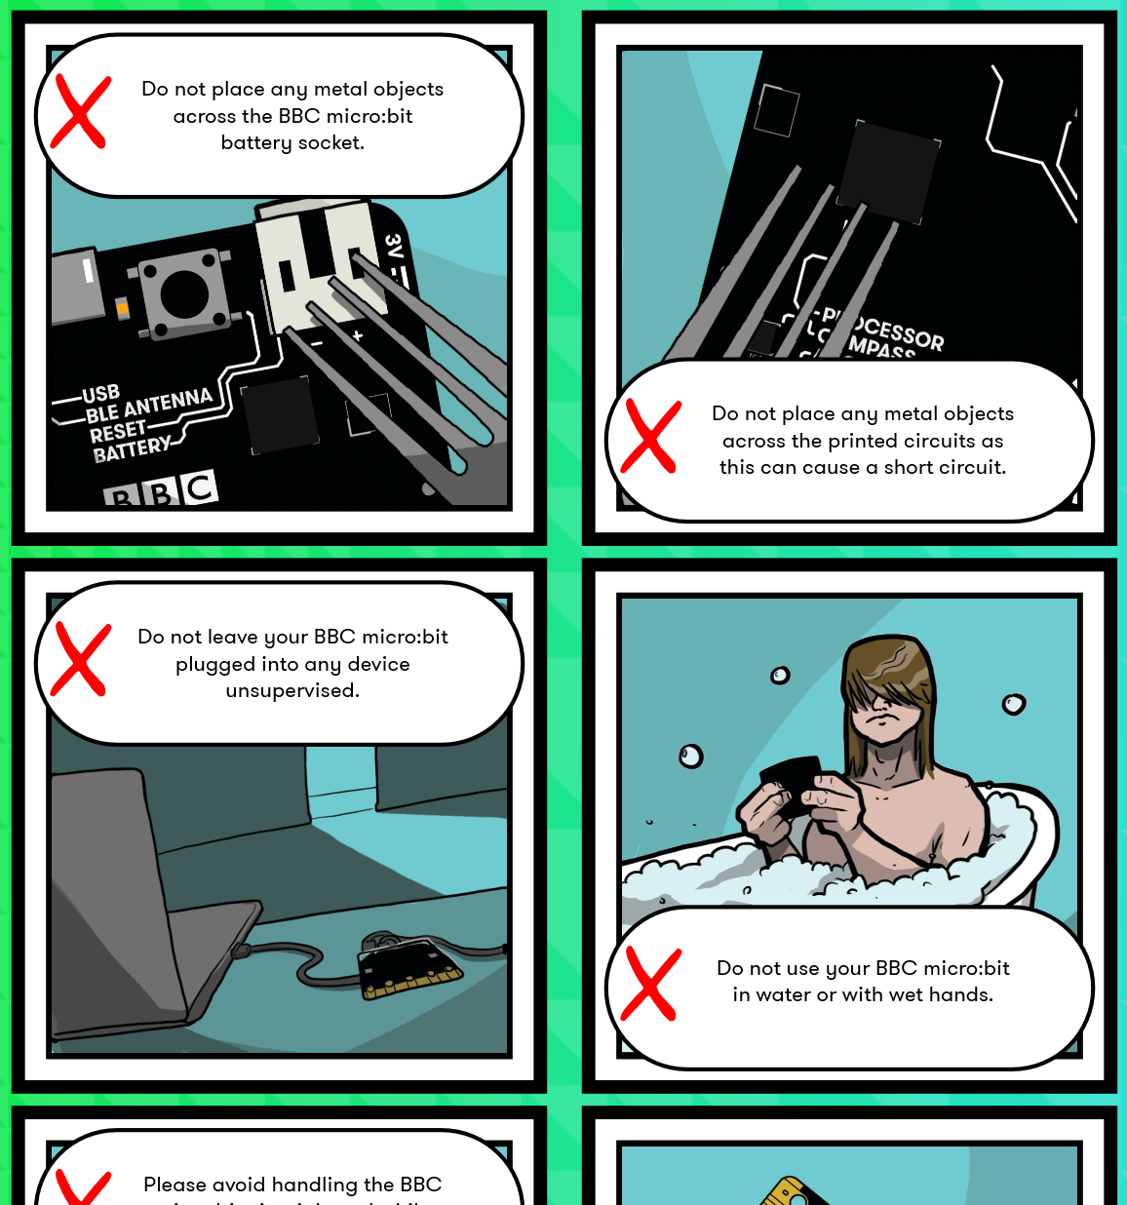
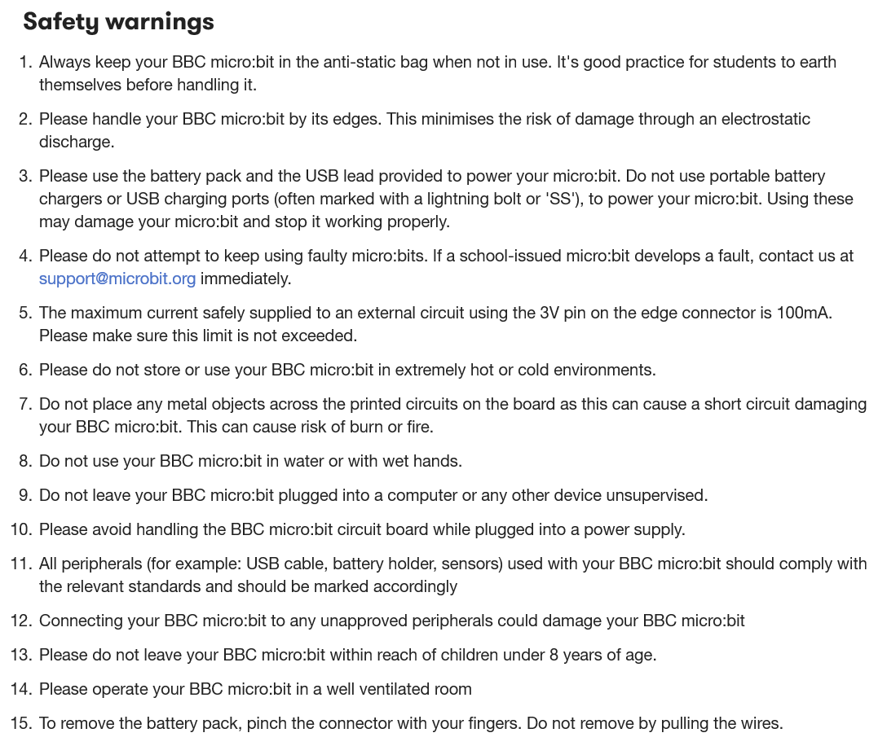
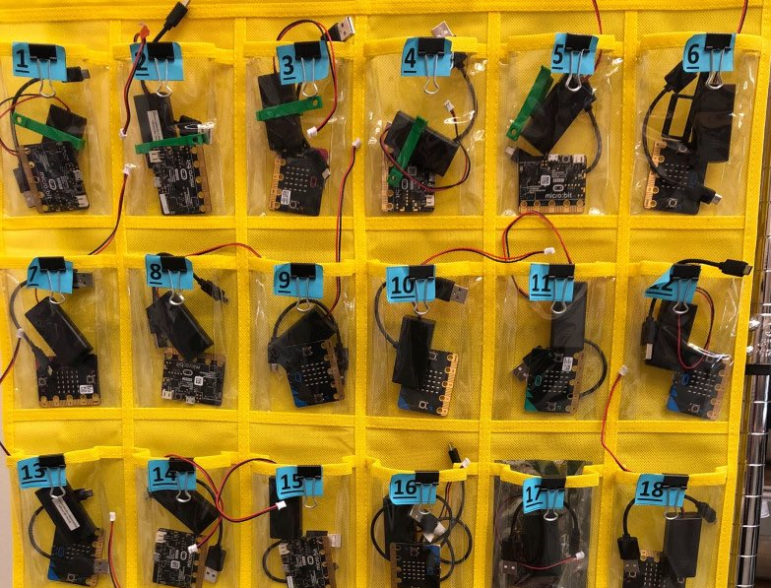
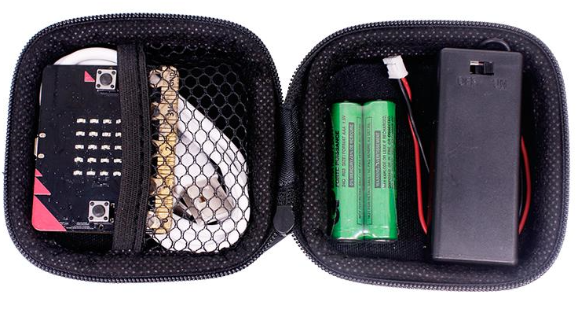
Taking Care of your micro:bit
Classroom Management Ideas
Student Safety Guide
Safety Guide
https://www.microbit.org/guide/safety-guide-page
https://www.microbit.org/guide/safety-guide-students

Slide 10
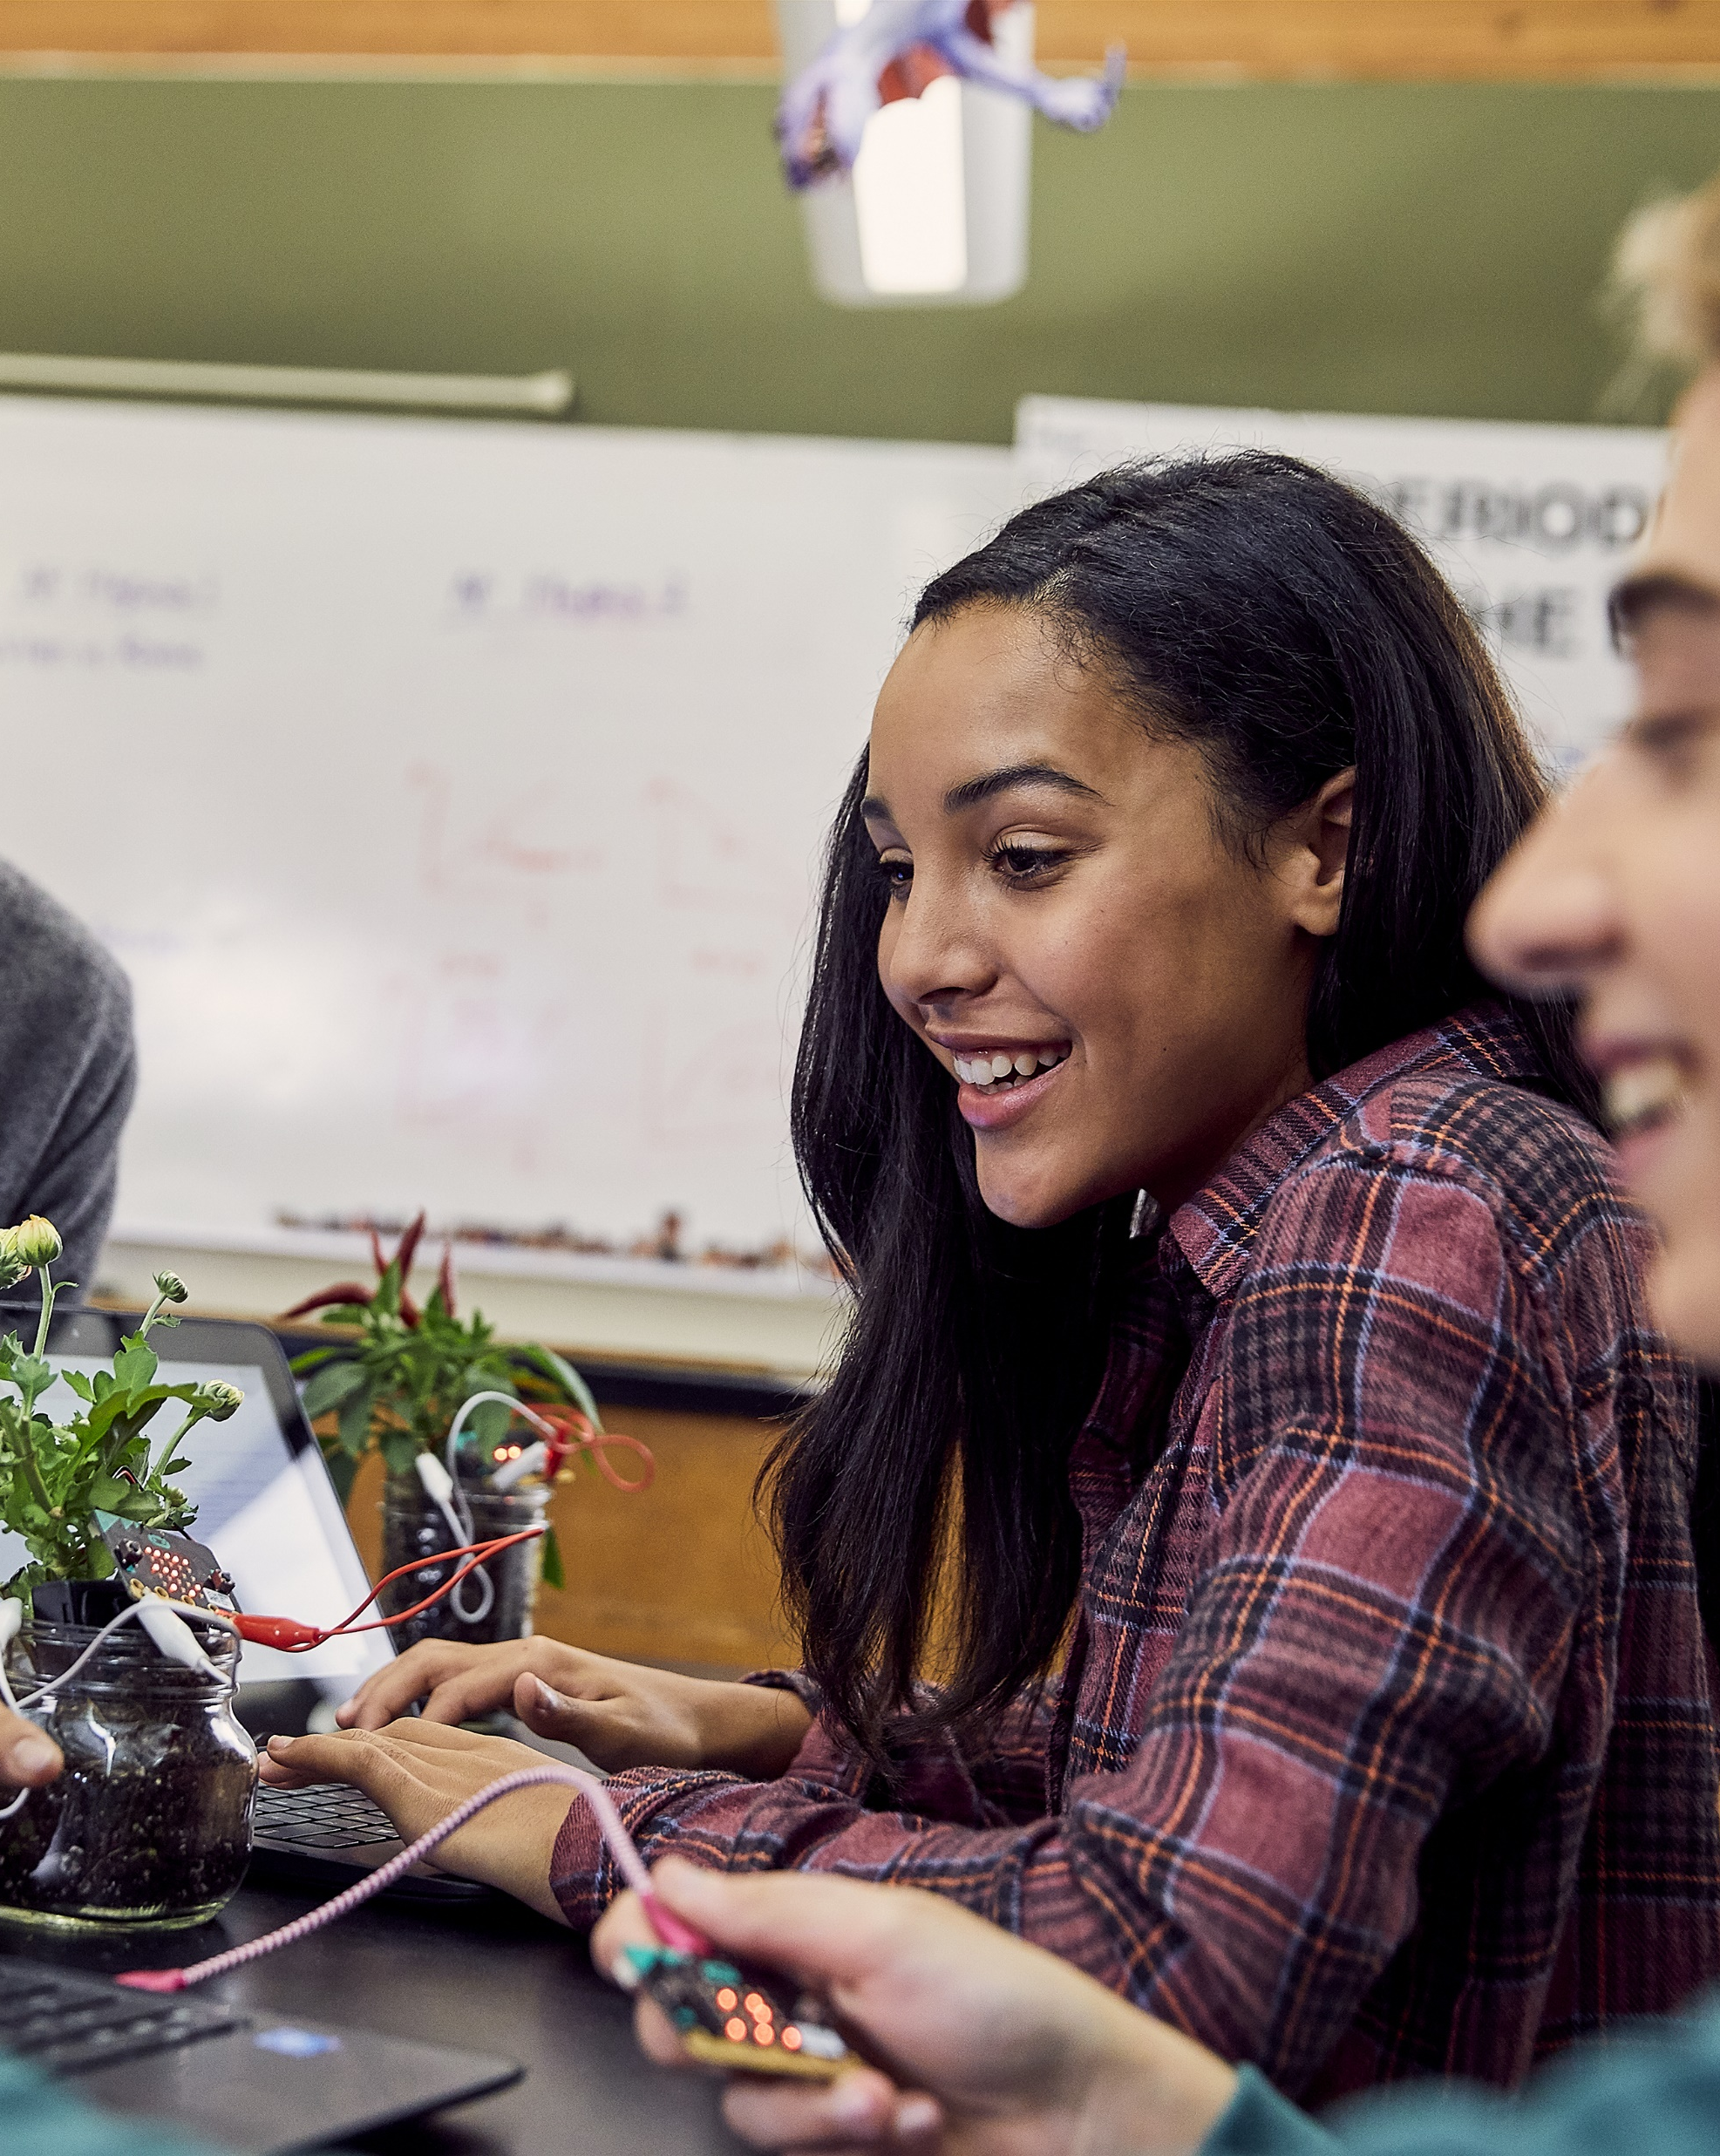
Microsoft MakeCode Hands-on Computing for every student
Just works always, everywhere
Physical and Immersive experiences as a more inclusive approach to computing education
Progression path to real-world skills
Extensible platform for partners
Notes:
MakeCode’s core product tenants are:
Just works always, everywhere – MakeCode “just works” for every teacher in every classroom. Nothing to download and install, cross-platform/device/browser, free, and open source.
Physical and Immersive experiences as a more inclusive approach to computing education – MakeCode curriculum and projects are designed to be fun and engaging for girls and other under-represented student populations
Progression path to real-world skills – MakeCode offers a progression path from drag-and-drop block-based programming to real-world JavaScript text-based programming with a fully featured IDE and the ability for students to switch back and forth between blocks and text coding.
Extensible platform for partners – MakeCode is an open source platform that provides a best-in-class learn-to-code framework for a variety of partners like LEGO and the micro:bit, and includes an extensibility model for custom blocks and accessories.

Slide 11
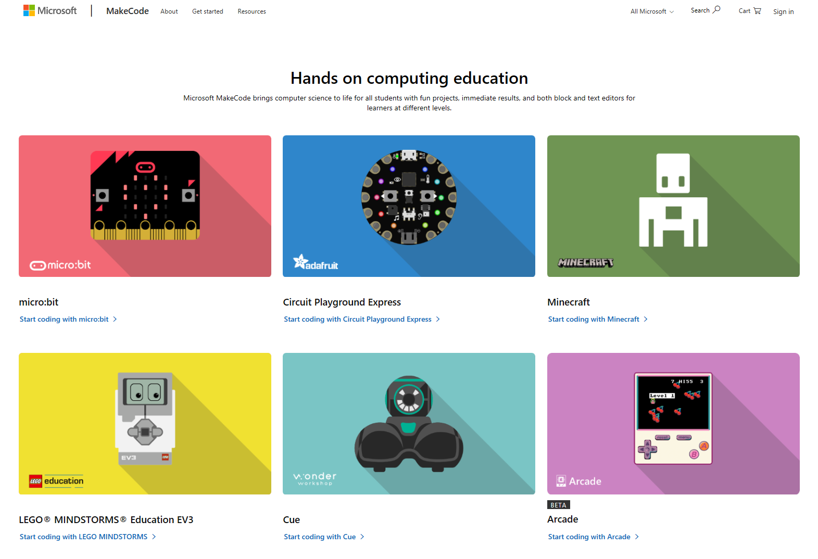
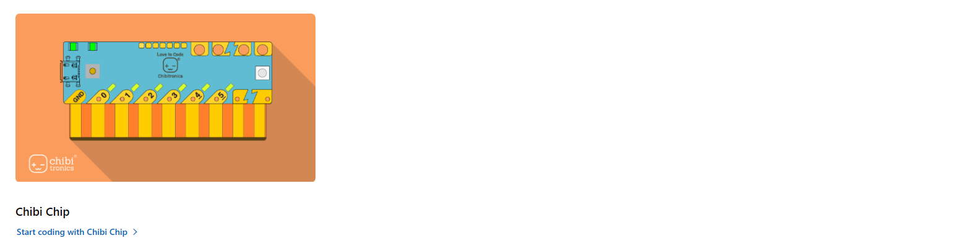
MakeCode.com
Notes:
Look at webpage – Get Started, Resources

Slide 12
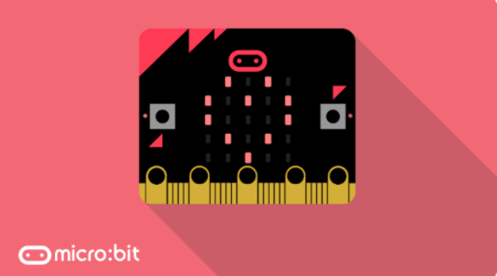
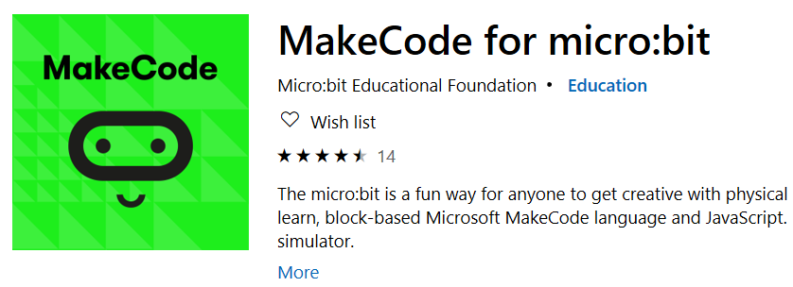
MakeCode for the micro:bit
Online at: makecode.com
Windows 10 app: aka.ms/microbitapp
Easier downloading
Serial data features
Offline

Slide 13
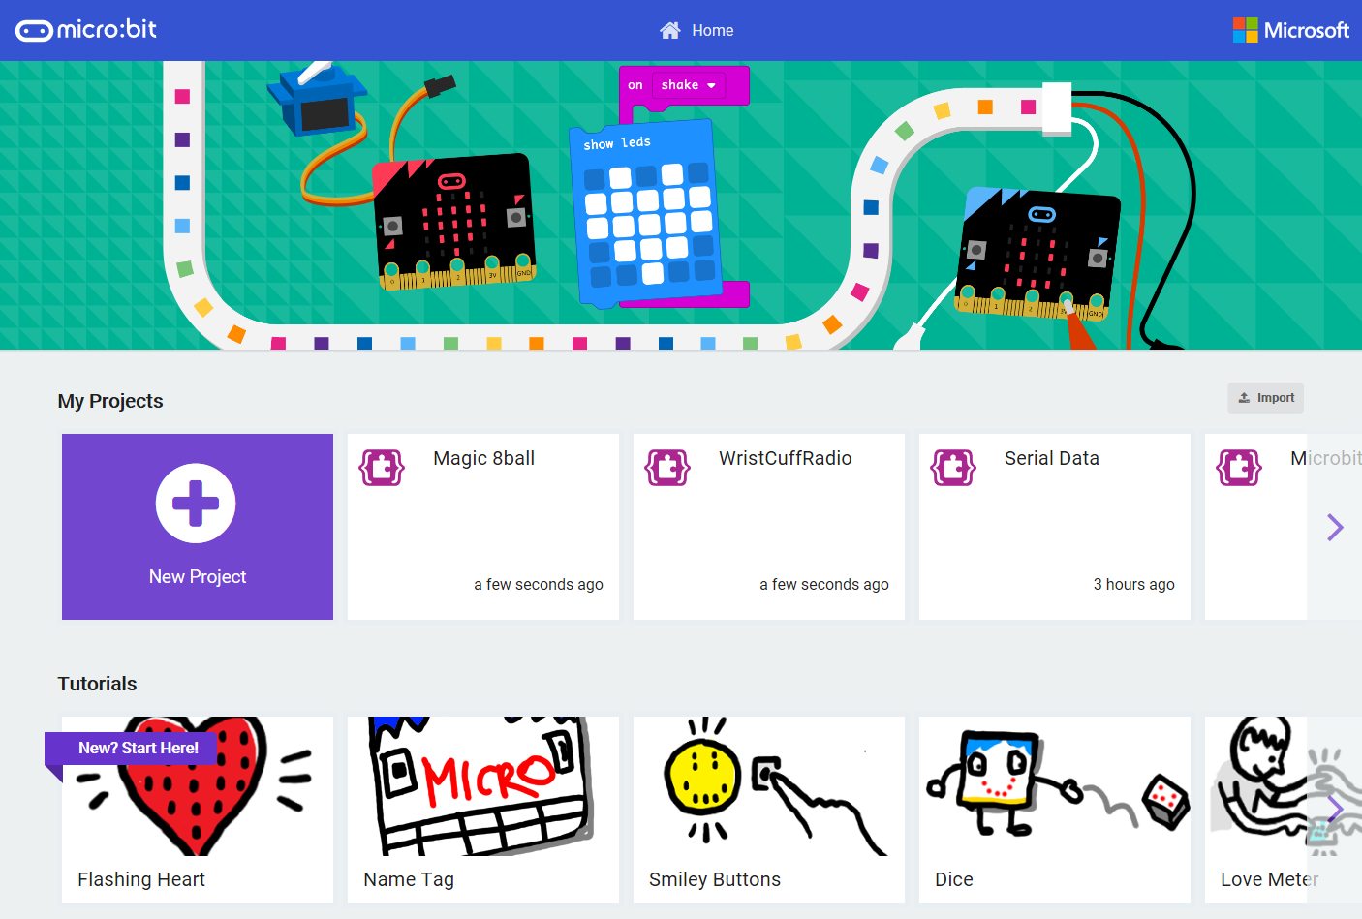
MakeCode for the micro:bit
Import program files (.hex) or shared project URL’s
Recent projects
Click on My Projects to see full list
Step-by-step Tutorials, Sample Projects, Curriculum, Videos
Notes:
Open up the MakeCode micro:bit app on your computer
You should see a Home Screen like this
There are step-by-step tutorials, projects, videos and code samples available from this page
On this Home page, you can also see a list of your recent projects and you can import existing programs via a shared URL or file
Go ahead and click to create a New Project

Slide 14
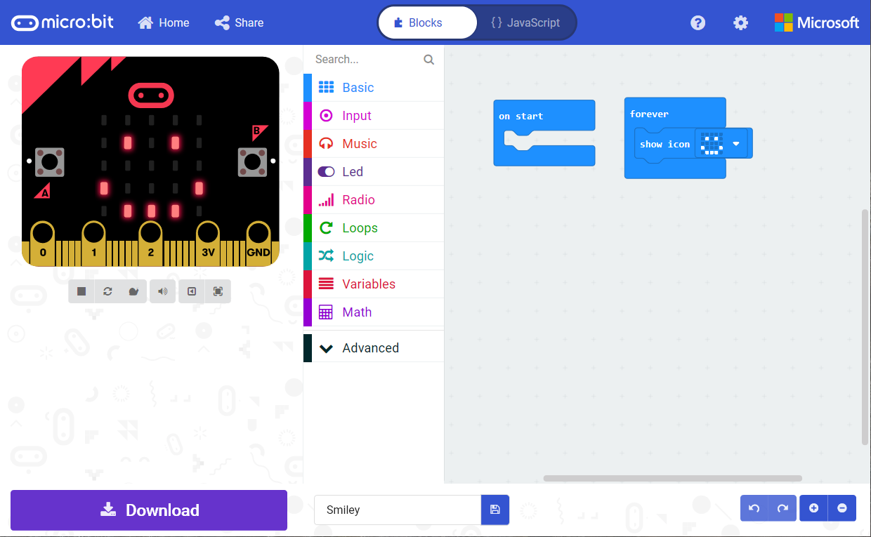
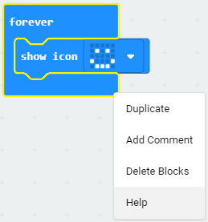
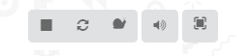
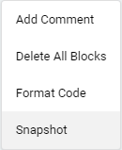
Share your Project
Go back to Home Page
Program in either Blocks or JavaScript
Right-click on a block for Context Menu
Block Toolbox
Programming Workspace where you will build your program
Simulator shows what your program will look like running on a micro:bit
Right-click for Workspace Context Menu
Simulator Toolbar
Undo/Redo and
Zoom Workspace
Download your Project to the micro:bit
Name your Project and Save it on your computer

Slide 15
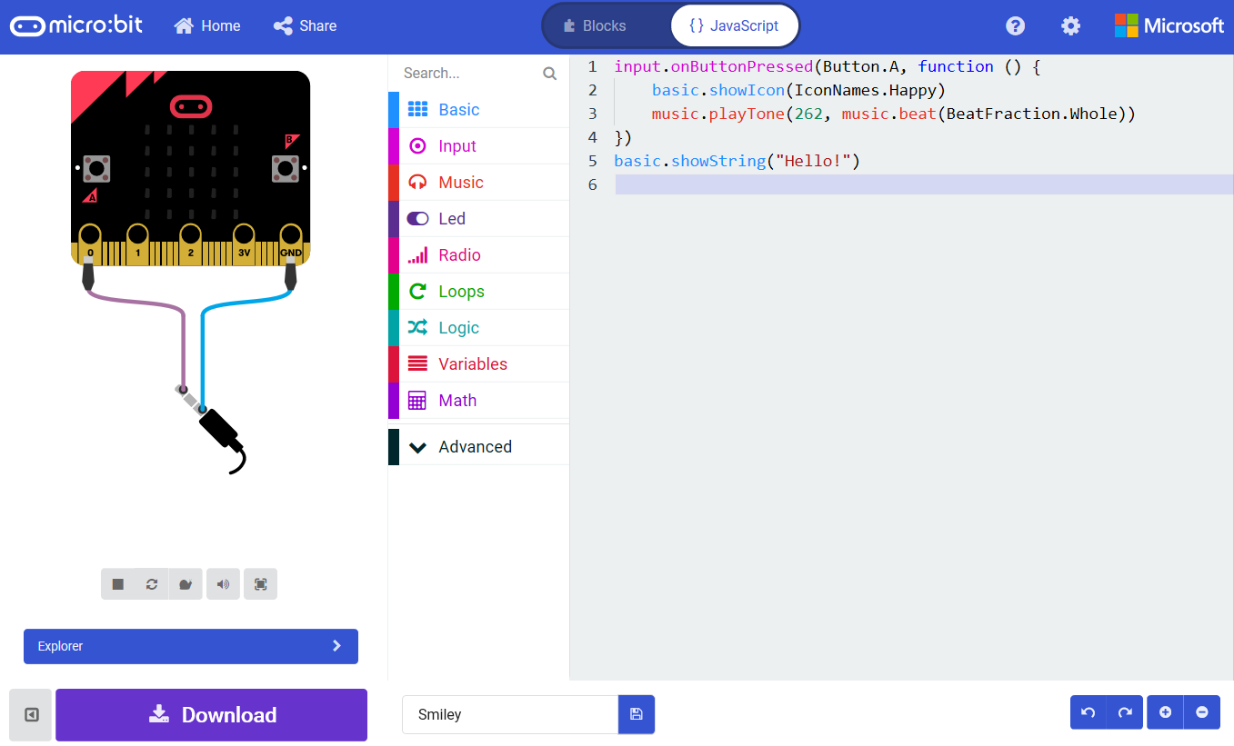
Notes:
Using the Toggle button on the top, you can switch into the JavaScript editor
More advanced students should feel free to program in JavaScript – there is intellisense, code completion and error detection to help you.
You can also use the Toolbox to drag out code snippets into the programming workspace.

Slide 16
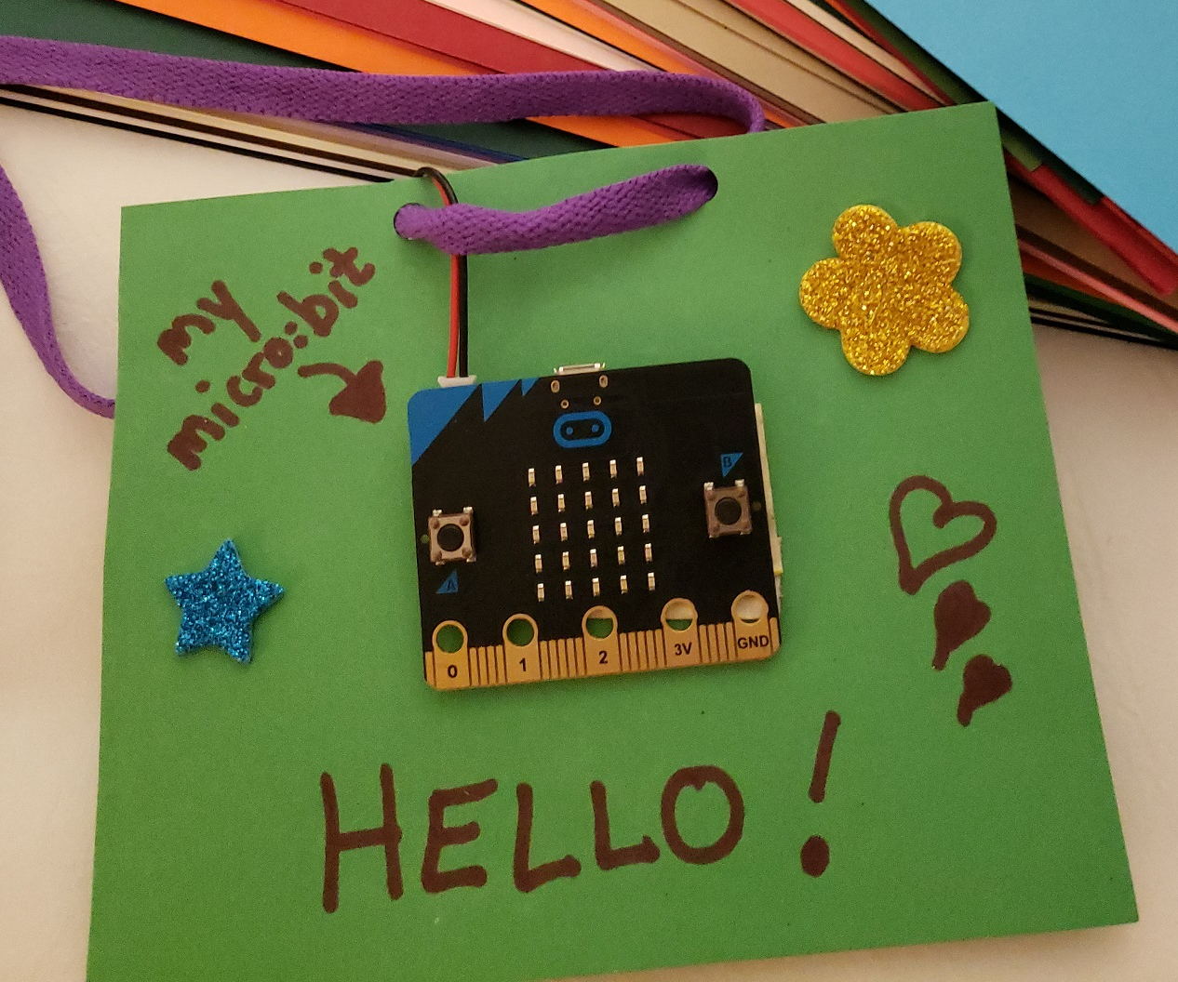
Micro:bit Rock Paper Scissors Name Tag

Slide 17
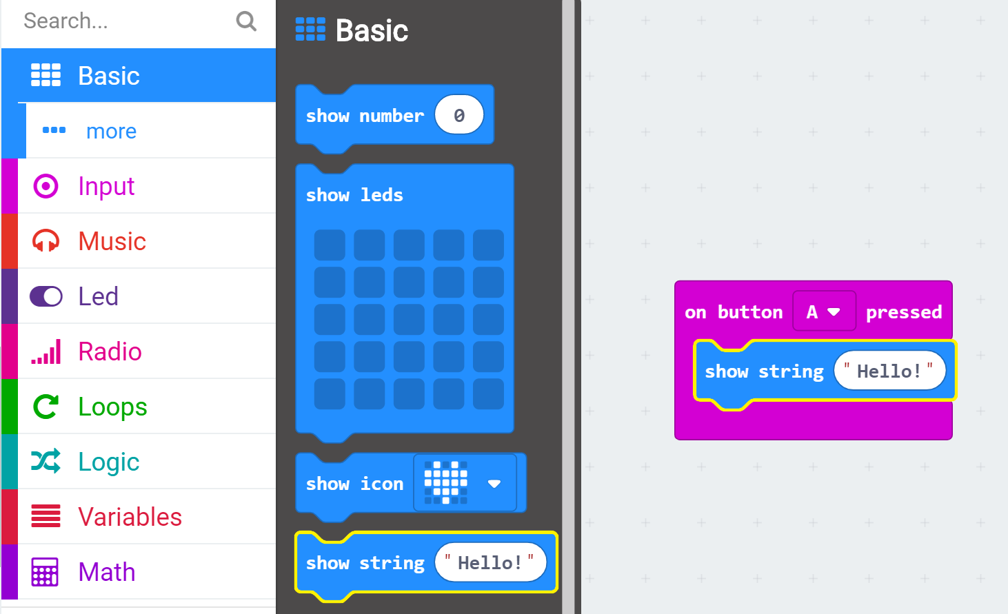
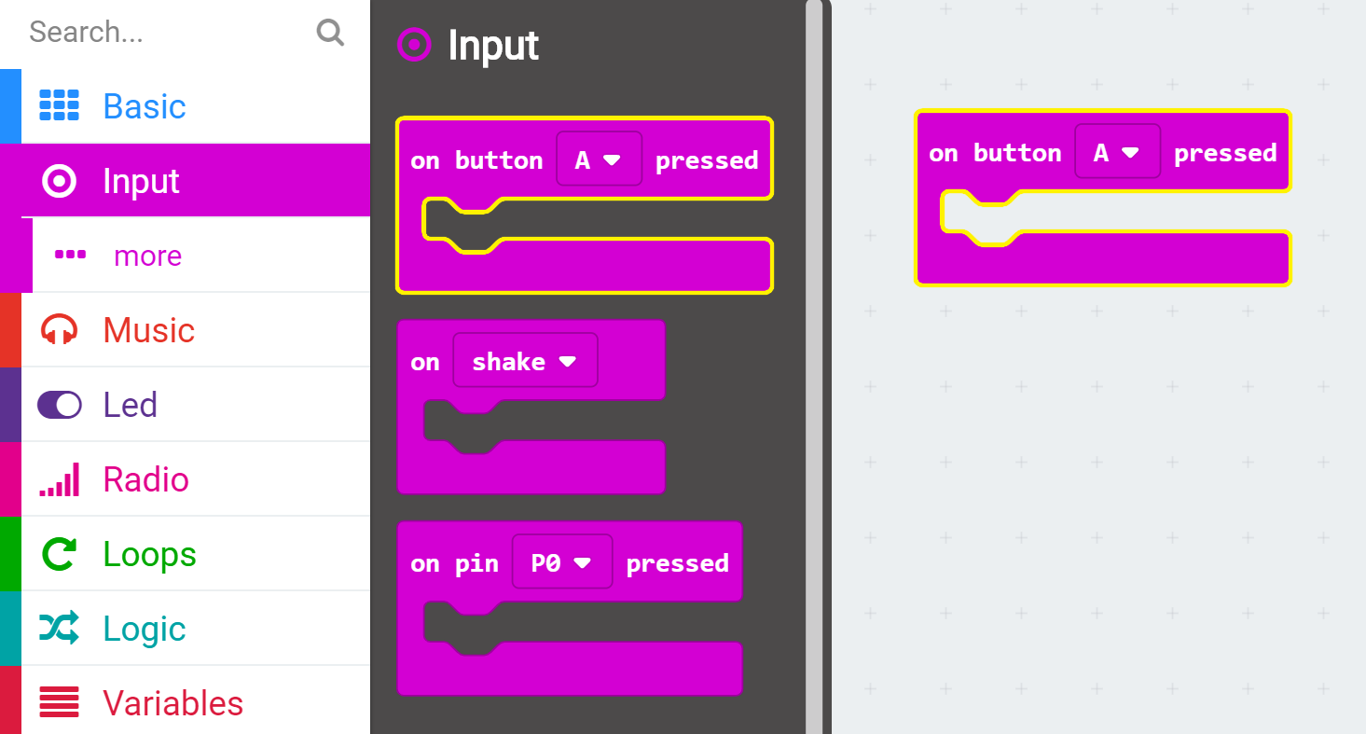
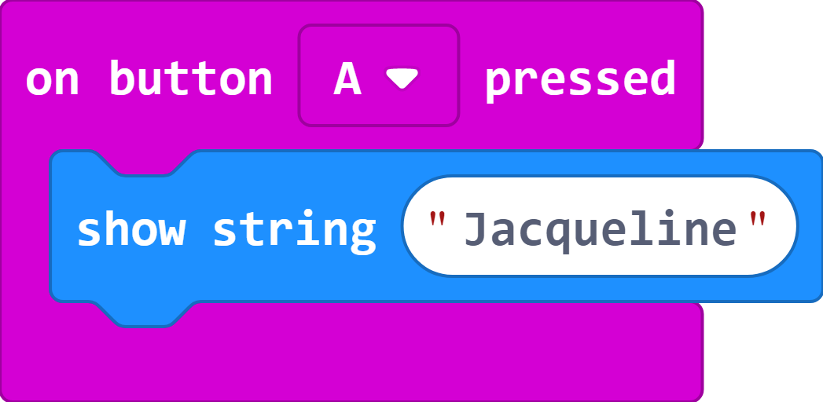
Show your name when you press a button
From the Input Toolbox drawer, drag an On Button A Pressed block onto the Workspace
From the Basic Toolbox drawer, drag a Show String block into the On Button A Pressed block
In the Show String block, type your name

Slide 18
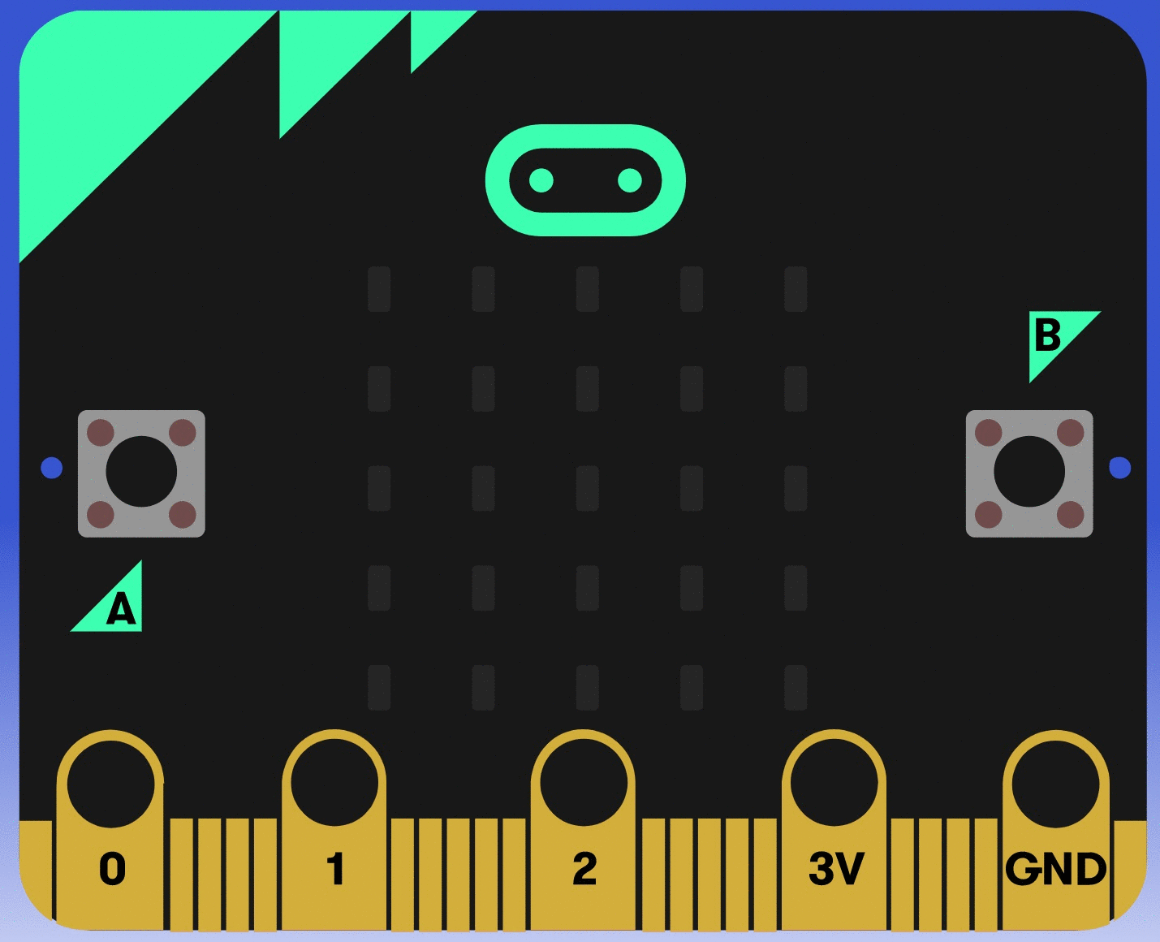
Test in the Simulator
Press Button A

Slide 19
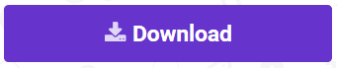
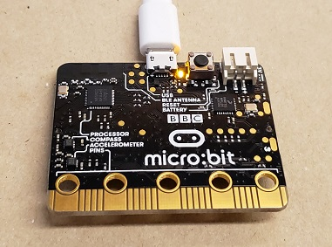
Download your program to the micro:bit
Make sure your micro:bit is plugged into the computer
Click Download Button
The Yellow light on the back of your micro:bit will flash while your program is downloading

Slide 20
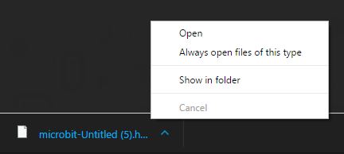
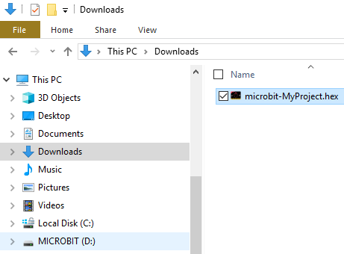
Download your program to the micro:bit
Plug in your micro:bit with USB cable
Click Download Button
Edge: Click Save As
Chrome: Select Show in folder
Copy your file over to the micro:bit USB drive

Slide 21
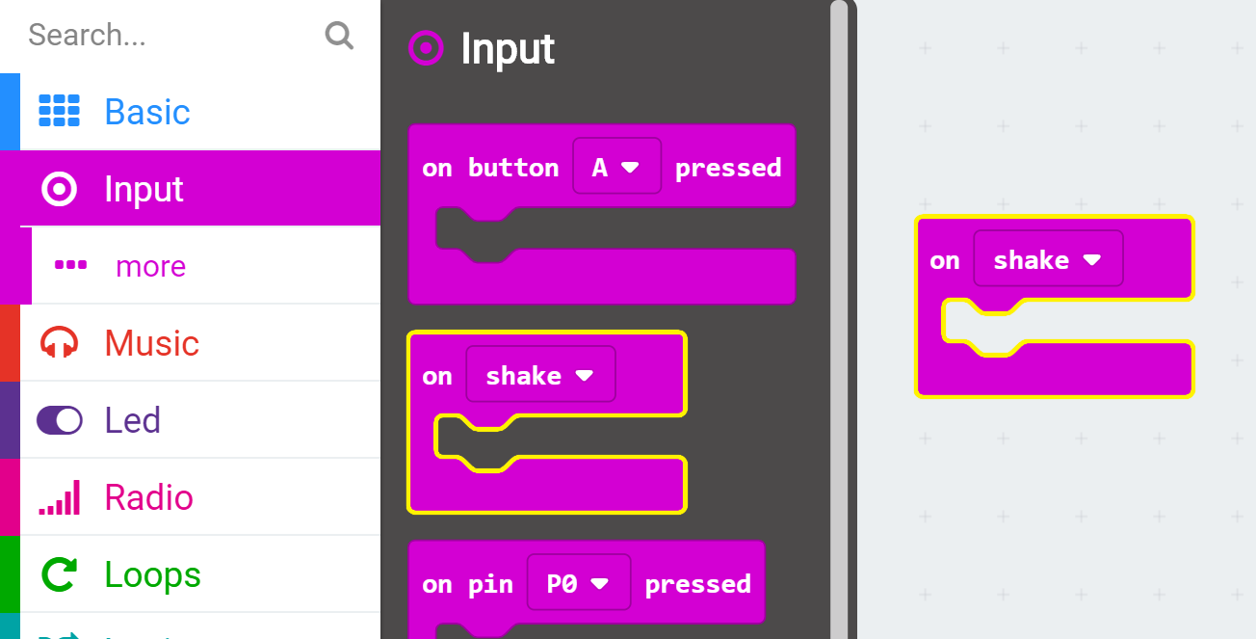
When you Shake the micro:bit, start the Rock Paper Scissors game
From the Input Toolbox drawer, drag out an On Shake block and drop onto the Workspace

Slide 22
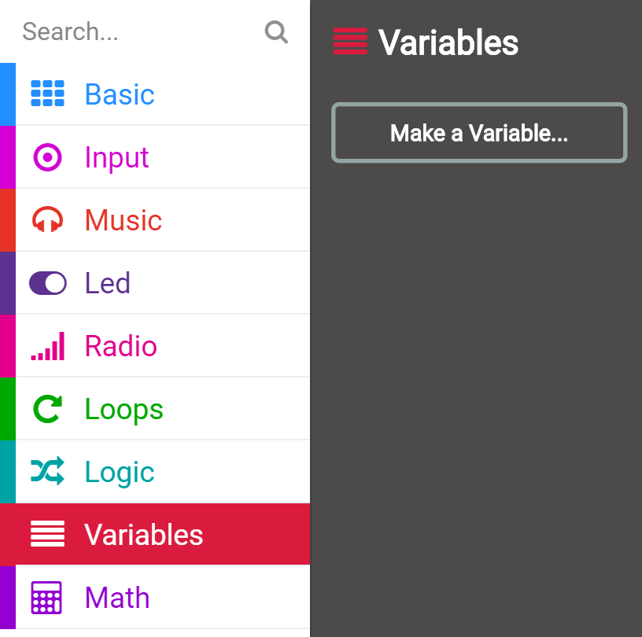
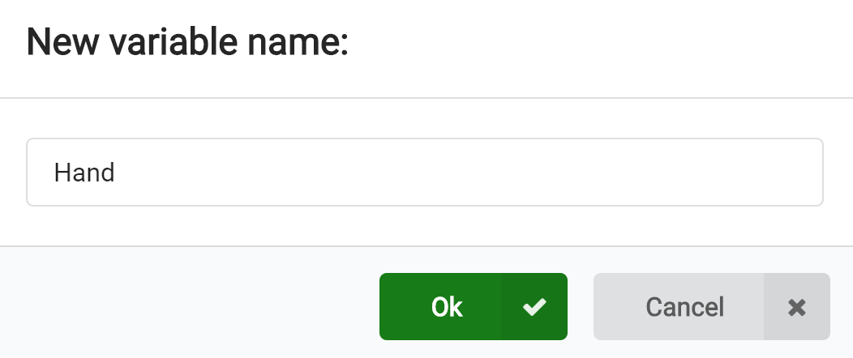
Create a Variable
Click on the Variables Toolbox drawer
Click on Make a Variable button
Name your variable “Hand”

Slide 23
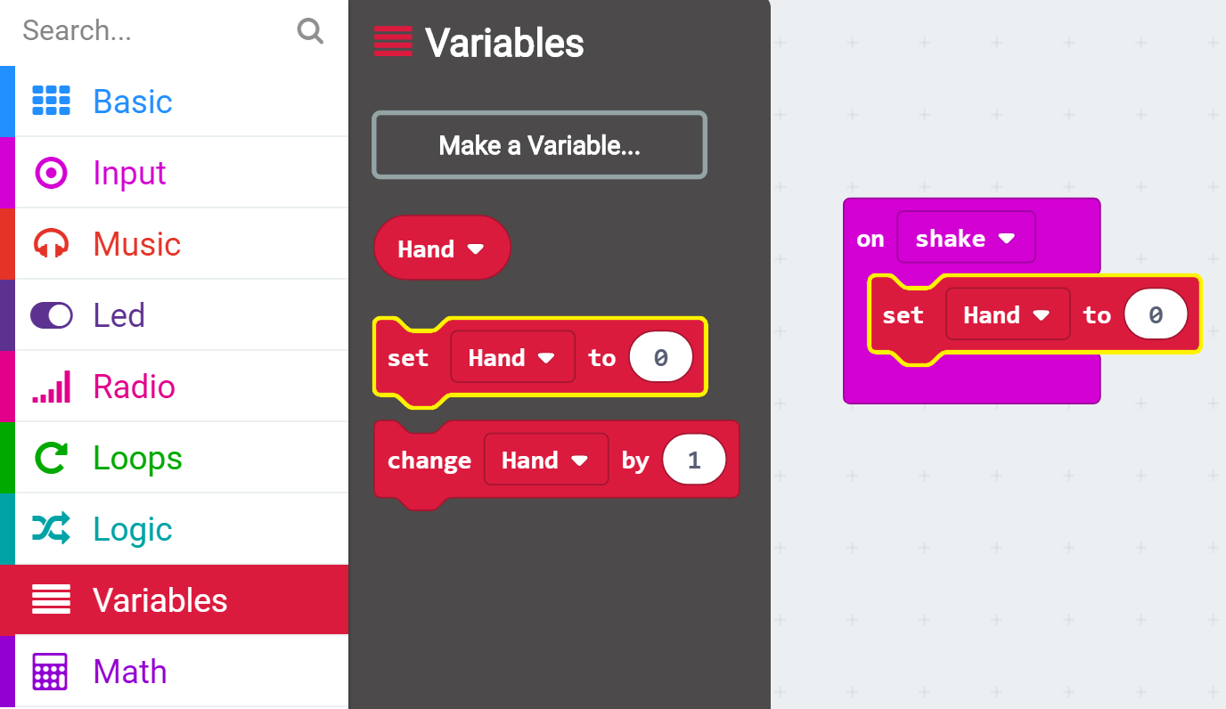
Set the value of the variable
From the Variables Toolbox drawer, drag a Set variable block and drop into the On Shake block

Slide 24
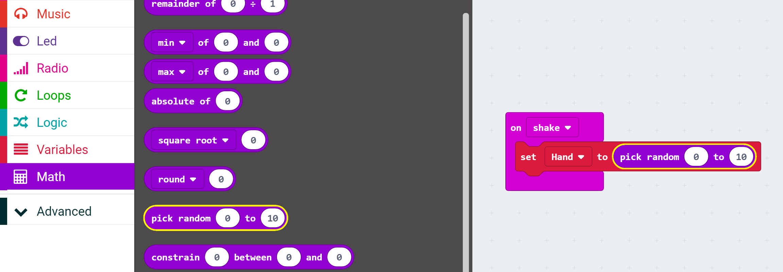

Set the value of the variable
From the Math Toolbox drawer, drag a Pick Random block and drop into the Set variable block replacing 0
Set the min value to 1 and max value to 3

Slide 25

Complete Code
https://makecode.microbit.org/_V7t2iL0phT25

Slide 26
Using the App… Download your program to the micro:bit
Make sure your micro:bit is plugged into the computer
Click Download Button
The Yellow light on the back of your micro:bit will flash while your program is downloading

Slide 27
From the Web… Download your program to the micro:bit
Plug in your micro:bit with USB cable
Click Download Button
Edge: Click Save As
Chrome: Select Show in folder
Copy your file over to the micro:bit USB drive

Slide 28


Make a Micro:bit Name Badge
Unplug micro:bit from Computer
Cut out a badge shape from a piece of colored construction paper
Loop a piece of duct tape and stick on the back of your micro:bit

Slide 29


Make a Micro:bit Name Badge
Stick your micro:bit onto the front of your badge
Using a hole-punch, punch out 2 holes in the top of your badge

Slide 30


Make a Micro:bit Name Badge
Attach battery pack to micro:bit
Tape battery pack onto the back of the badge

Slide 31


Make a Micro:bit Name Badge
Thread a shoelace through the top 2 holes of your badge
Tie a knot at the end of your shoelace

Slide 32

Make a Micro:bit Name Badge
Decorate your badge with colored paper, markers, stickers

Slide 33

Curriculum
https://makecode.microbit.org/courses/

Slide 34








Example student projects
WRIST CUFFS
SOIL MOISTURE
MICRO PETS
AIR GUITARS
WALLET/PURSE
LIGHT MONSTERS
FIDGET CUBES
INCH WORM

Slide 35



Resources
MakeCode.com

Slide 36

Links
aka.ms/ISTEslides
Online MakeCode editors
https://makecode.com
Order hardware
http://microbit.org/resellers/
Apps
http://aka.ms/microbitapp
Curriculum
https://aka.ms/intro2csmicrobit
@MSMakeCode
Notes:
Microsoft MakeCode represents an inclusive approach to computer science education through hands-on, immersive, cross-curricular learning experiences that are engaging and personally meaningful to every student.
As a platform, Microsoft MakeCode partners with any educational product that needs a best-in-class learn-to-code editor that takes students from a visual drag-and-drop environment, into a full, real-world text-based programming paradigm.
Microsoft MakeCode is open-source, and free.
Our vision is for every child to have access to, and the desire for a high-quality, fun and personal computer science education.
Learn more at makecode.com

Slide 37
Thank You!

